Slide 1
Generating a Fungal Index
For the SRA

Slide 2
Background
The NCBI SRA (sequence read archive) is a repository of high-throughput sequencing data. Fungal researchers are interested in being able to quickly pull out relevant data from SRA, especially from metagenomic experiments, without having to perform intensive BLAST searches each time.
Our aim is to generate biologically relevant SRA indices that list SRA records containing fungal sequences along with relevant metadata.
This exercise should serve as a general pattern for creating useful indices of the SRA

Slide 3
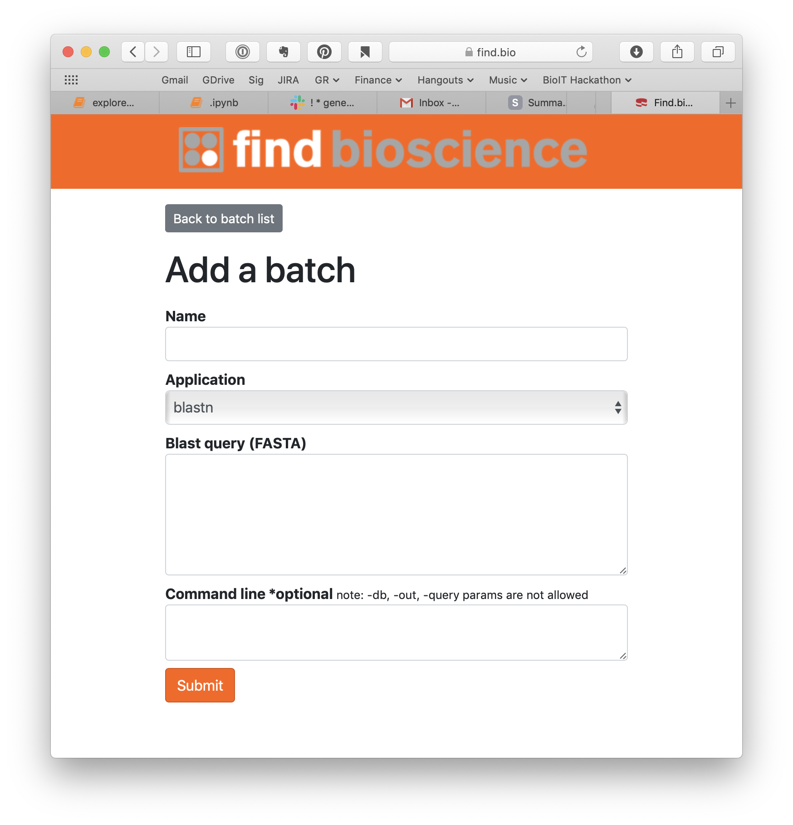
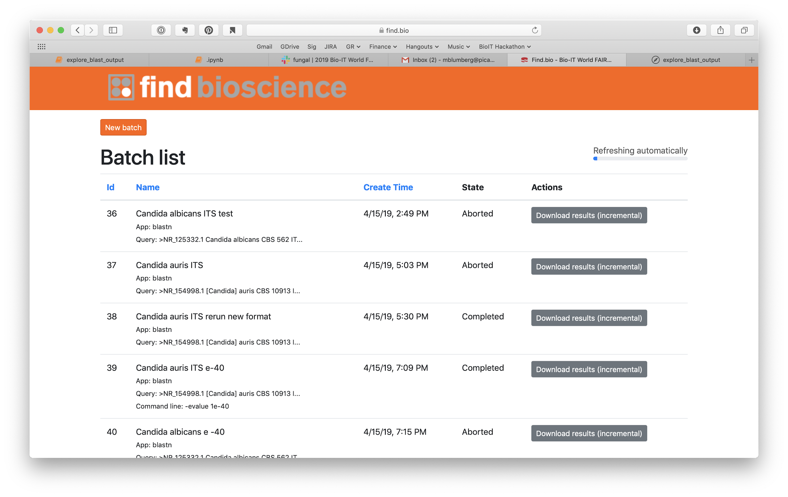
Process: BLAST Search Tool

Slide 4
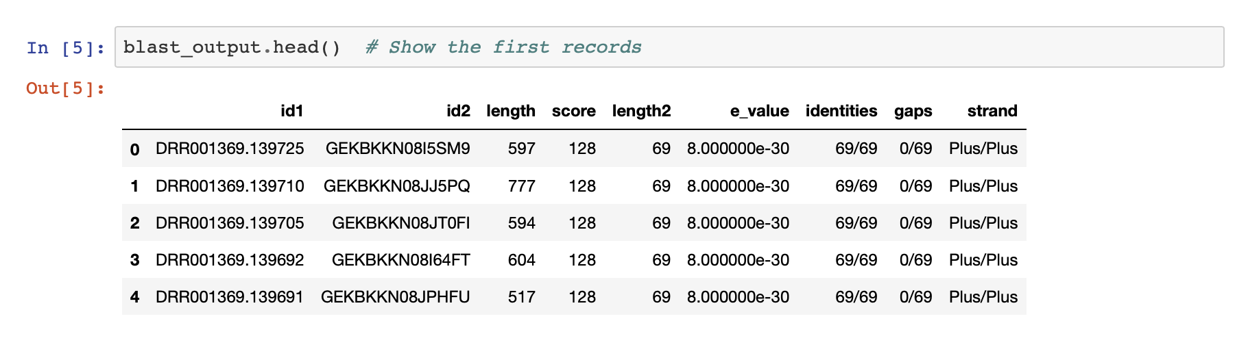
Process: Initial Results: BLAST output only
(*Search results loaded into Pandas dataframe to allow interactive work in Jupyter)

Slide 5
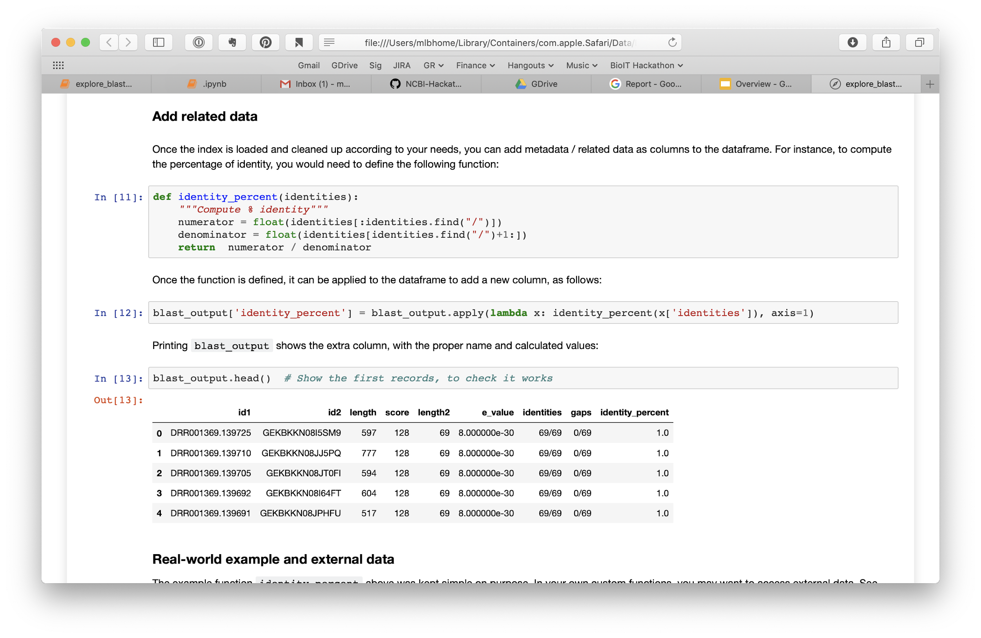
Process: Extend Metadata with python functions

Slide 6
RESULTS: First Run
Dataset: “WGS-Metagenomic Datasets from the SRA” - ~78,000 SRA accessions (Datasets with high frequency of 32-mers that match exactly to unique fungal sequences)
Query: 10,400 NCBI Fungal ITS reference set
Goal: Find-- and index-- all instances of each of the 10,400 fungal species in the provided dataset
Results: Table of BLAST matches (>99% identity): 7,792,894 hits - saved as a reusable FAIR (*I think) index

Slide 7
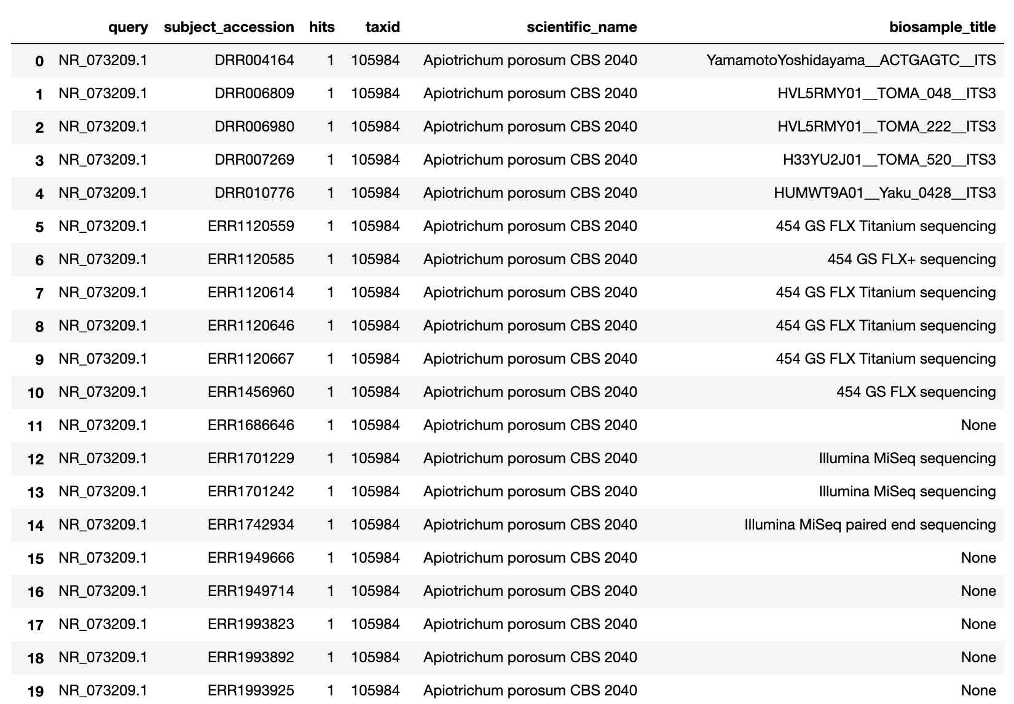
In Progress: Enhancing Index with Metadata
Fields added from SRAdb, Biosample, and computed values

Slide 8
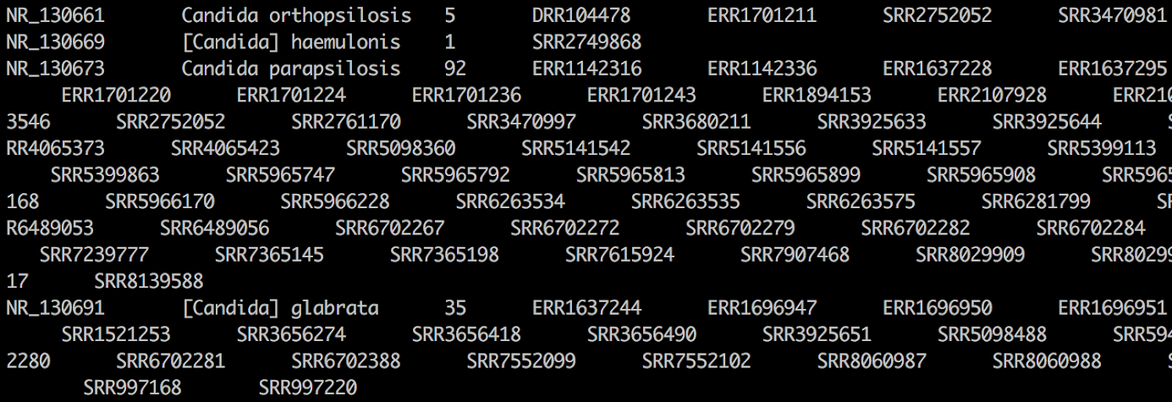
In Progress: Summarizing Results by Query
Summarizing results by query (i.e. function to sort hits by species)

